Slide 1
Topic 8: Gravitational Field
8.1 Gravitational field
8.2 Force between point masses
8.3 Field of a point mass
8.4 Field near to the surface of the Earth
8.5 Gravitational potential

Slide 2
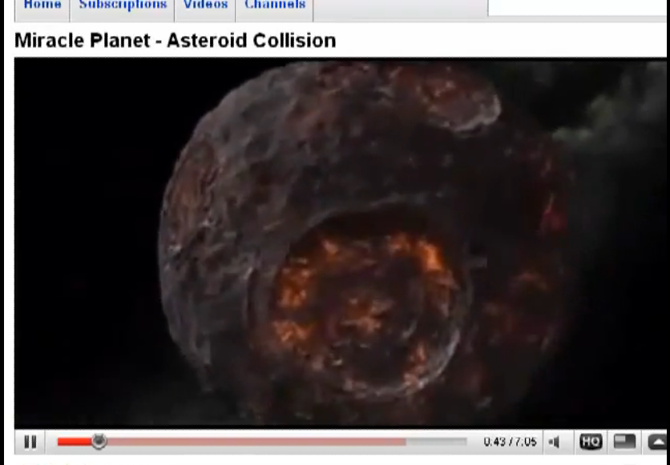
Gravitational Potential Energy
http://www.youtube.com/watch?v=4Nziux6sejU

Slide 3
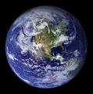
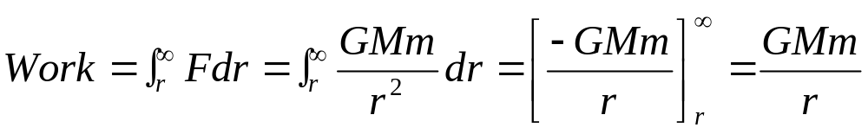
Work Done
∞
r
When we move a body of mass m from r to ∞ against gravity we are doing work onto it.
Maximum work is done unto it at ∞.

Slide 4
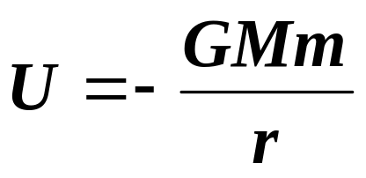
Gravitational Potential Energy
m
∞
M
r
U = 0
The gravitational potential energy U of a mass at a point is defined as the work done on the mass in moving it from infinity to that point.
Gravitational potential energy at infinity is fixed at zero.
Hence when m is moved from infinity to its new position, it would lose potential energy to attain a negative value.
As it moves further away from infinity, the gravitational potential energy U that it possesses decreases to a smaller value.

Slide 5
Gravitational Potential Energy
C
B
A
m
If m moves from B to A , work done on it is positive, its gravitational potential energy U increases. The mass m must initially be given a kinetic energy.
If m moves from A to B, work done on it is negative, its gravitational potential energy U decreases. Its kinetic energy increases.
If m moves along BC, no work is done as the gravitational force acting on it is always perpendicularly to the direction of motion.

Slide 6
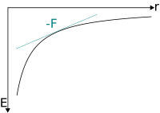
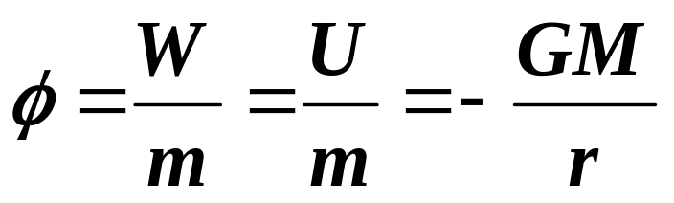
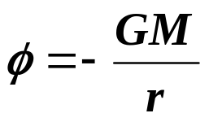
Gravitational Potential
P
∞
m = 1 kg
The gravitational potential φ at a point P, is defined as the work done in bringing unit mass from infinity to that point.
The gradient of a graph of gravitational potential energy against distance is the magnitude of the force.
Unit of φ = J kg⁻¹

Slide 7
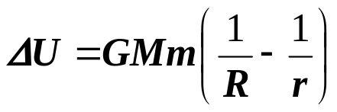
Change in Gravitational Potential Energy
A satellite of mass m is lifted to an orbit r from the centre of the Earth. If the radius of the Earth is R and its mass is M, show that the change in gravitational potential energy is
m
Solution:
U_{surface} = -GMm / R
U_{orbit} = -GMm / r
ΔU = U_{orbit} – U_{surface}
= -GMm / r − (-GMm / R)
= GMm (1/ R – 1/r )
r
M
R

Slide 8
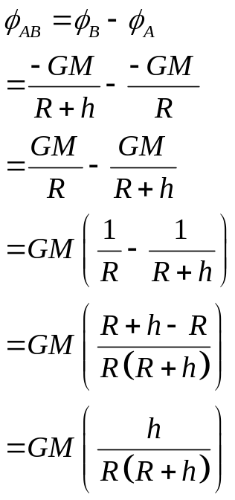
Gravitational Potential Energy at Earth’s Surface
The change in gravitational potential energy close to the Earth’s surface can be obtained by considering a 1 kg mass placed at B, which is at a height h close to the Earth’s surface.
Change in gravitational potential from A to B is given by:
φ_{AB} = φ_{B} – φ_{A}
= -GM / (R + h) – [-GM / R]
= GM [1/R – 1/(R + h)]
= GMh / R(R + h)
h << R, therefore R(R + h) ≈ R²
φ_{AB} = GMh / R² = gh
Therefore change in gravitational potential energy:
U_{B} – U_{A} = φ_{AB} × m = mgh
B
h
A
R

Slide 9
Example 2
(a) What is the gravitational potential at X and Z?
(b) Why is gravitational potential energy negative?
(c) What is the change in potential energy of a 1 kg mass when it is moved from (i) Y to X (ii) Y to Z (iii) Z to X
Solution:
(a) φ_{X} = φ_{Y} = -10 kJ kg⁻¹
φ_{Y} = -GM/L = -10
φ_{Z} = -GM/2L = ½ φ_{Y} = -5 kJ kg⁻¹
Since we have defined the maximum potential energy of a mass at infinity as zero, all potential energies at any other points must be negative.
(i) U_{YX} = U_{X} - U_{Y} = m(φ_{X} - φ_{Y})
= 1[-10 – (-10)] = 0 kJ kg⁻¹
No loss or gain in potential energy
(ii) U_{YZ} = U_{Z} - U_{Y} = m(φ_{Z} - φ_{Y})
= -5 – (-10) = 5 kJ kg⁻¹
Gain in potential energy
(iii) U_{ZX} = U_{X} - U_{Z} = m(φ_{X} - φ_{Z})
= 1[-10 – (-5)] = -5 kJ kg⁻¹
Loss in potential energy
2L
L
Y
Z
X
Each of the concentric circles in the diagram represents points that have the same potential. X and Y are two points that lie on the smaller circle of radius L while point Z lies on the larger circle of radius 2L. The gravitational potential at Y is -10 kJ kg⁻¹.

Slide 10
Example
(a) Show that the gravitational potential at the surface of the Earth is −63 MJ kg⁻¹; given the surface gravitational field strength is 9.8 N kg⁻¹ and the mean radius of the Earth is 6400 km.
(b) Calculate the loss of gravitational potential energy of a meteorite of mass 0.10 kg that falls to Earth from space.
Solution:
(a) gravitational potential φ = -(field strength × radius)
= -9.8 × 6400 × 10³
= -62.72 × 10⁶
= -63 MJ kg⁻¹
(b) As the meteorite falls from infinity where the potential is zero, loss of gravitational potential energy, ΔU
= (0 - φ_{R)} × mass
= 63 × 10⁶ × 0.10
= 6.3 MJ

Slide 11
Gravitational Escape Velocity
When an object is projected directly upward from a planet, moon or sun with an initial velocity, it will start to slow due to the gravitational force pulling it back toward the surface.
However, if the velocity is great enough, the object will never slow to zero velocity to return to its surface. That velocity is called the gravitational escape velocity.
Gravitational escape velocity is the minimum speed required for an object to escape completely from the gravitational pull of a body and never fall back to its surface.

Slide 12

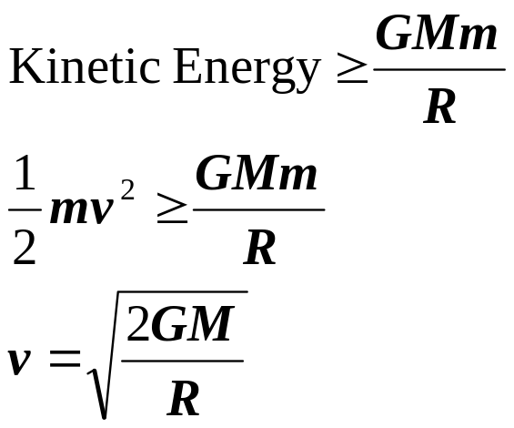
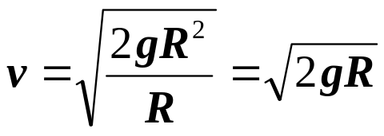
Escape Velocity
∞
To launch a rocket of mass, m from the earth’s surface so that it escapes completely from the gravitational attraction of the earth, the rocket must take off from earth with enough kinetic energy to overcome the gravitational potential energy.
m
Escape speed
M
But GM = gR²
Therefore

Slide 13
Escape Speed of Earth
∞
If the radius of the Earth is 6.4 × 10⁶ m and the value of g at its surface is 9.81 N kg⁻¹, calculate the escape speed of a unit mass from the Earth.
Solution:
v = √(2gR)
= √(2 × 9.81 × 6.4 × 10⁶)
= 11.2 kms⁻¹
m
v = 11.2 kms⁻¹
M

Slide 14
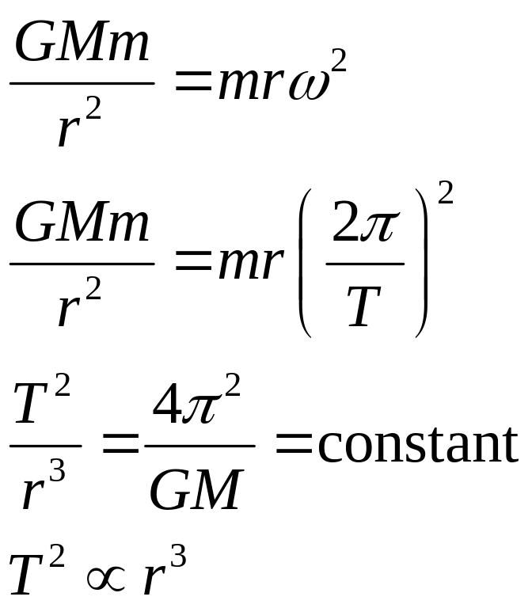
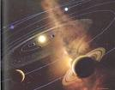
Period & Radius
When a planet revolves round the Sun, the centripetal force required is provided by the gravitational force:
Kepler’s Third Law of Planetary Motion

Slide 15
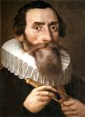
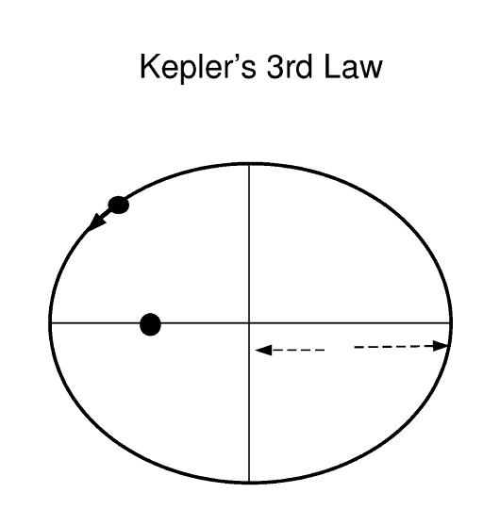
Kepler’s Third Law of Planetary Motion
Law 3: The squares of the periods of revolution of the planets about the Sun are proportional to the cubes of their mean distances from the sun.
T² ∝ r³
T² ∝ r³
T² / r³ = constant
Johannes Kepler 1571-1630
Astronomer & Mathematician
r

Slide 16
Keplers 3 Laws of Planetary Motion
Law 3: The squares of the periods of revolution of the planets about the Sun are proportional to the cubes of their mean distances from the sun.
Example:
Planet | Period (s) | Average Dist. (m) | T²/R³ (s²/m³)
Earth | 3.156 x 10⁷ s | 1.4957 x 10¹¹ | 2.977 x 10⁻¹⁹
Mars | 5.93 x 10⁷ s | 2.278 x 10¹¹ | 2.975 x 10⁻¹⁹
constant

Slide 17
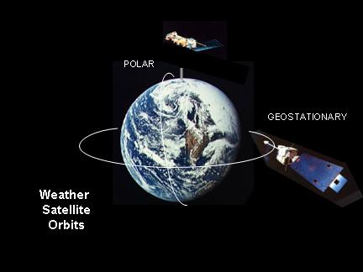

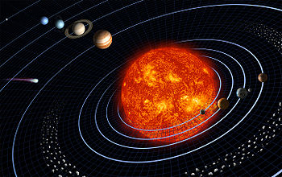
Satellite
A satellite is a body that orbits round another body.
It can be
natural such as the moon revolving round the Earth or
artificial as launched by human for navigation or communication purpose

Slide 18

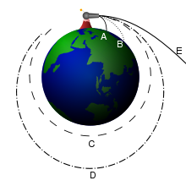
Launching a Satellite
To set a satellite in orbit, it is first carried to the required distance from the earth. Then the satellite is launched in a direction parallel to the earth’s surface with a definite velocity, v.
If the satellite is launched with a velocity which is less than the required value, it would come crashing onto the earth’s surface.
If the satellite is launched with a higher velocity than required, the subsequent orbit is elliptical, with the earth as one of the foci of the ellipse.

Slide 19
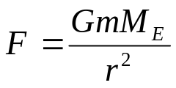
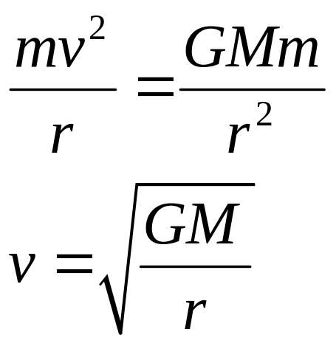
Speed of a Satellite
How much speed to give to a satellite so that it orbits in a circular path?
To be in circular orbit, the centripetal force required is provided by the gravitational force F . If m = mass of satellite, M = mass of the planet, r = radius of circular orbit, G = gravitational constant, then :
If a satellite is launched with this velocity, it would go in a circular orbit.

Slide 20
Example
Calculate the speed of the satellite orbiting the Earth at a height of
(a) 2000 km (b) 30 000 km.
(G = 6.67×10⁻¹¹ Nm²kg⁻², M_{E} = 6.0 × 10²⁴ kg,
R_{E} = 6.4 × 10⁶ m )
Solution:
(a) v = √(GM_{E}/r)
= √(6.67×10⁻¹¹ × 6.0×10²⁴) / (6.4×10⁶ + 2×10⁶)
= 6902 = 6900 ms⁻¹
(b) v = √(GM_{E}/r)
= √(6.67×10⁻¹¹ × 6.0×10²⁴) / (6.4×10⁶ + 30×10⁶)
= 3316 = 3300 ms⁻¹

Slide 21
Example
For a satellite which is close to the earth’s surface, its radius of orbit may be assumed to be equal to the earth’s radius = 6.4 × 10⁶ m. Estimate
(a) the speed (b) the period of the satellite
Solution:
(a) mv² / r = GMm / r²
v = √(GM / r )
= √[6.67 × 10⁻¹¹ × 6.0 × 10²⁴ / 6.4 × 10⁶
= 7907 = 7900 ms⁻¹
(b) T = 2πr / v = 2π × 6.4 × 10⁶ / 7900
= 5092 = 5100 s

Slide 22
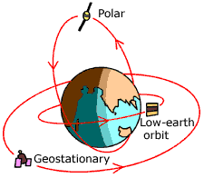
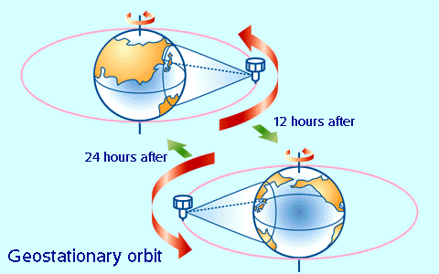
Geostationary Satellite
Geostationary satellite is found above the same point on Earth at all time. Geostationary satellite is a synchronous satellite.
Synchronous satellites are satellites that revolve round the earth at the same time rate as the rotation of the earth about it axis.
Synchronous satellites have a period of 24 hours and appear stationary when seen from earth.
It orbits the earth in the same direction as the rotation of the earth i.e. west to east.
To be synchronous the plane that contains the orbit of the satellite is in the same plane as the equator.

Slide 23
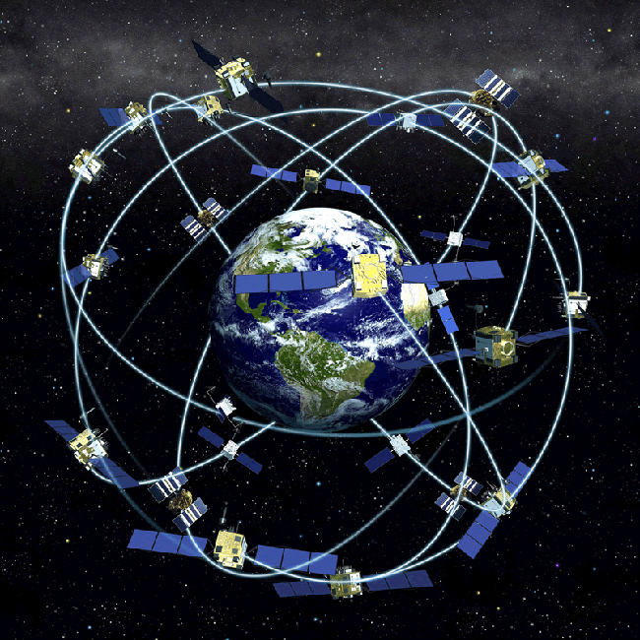
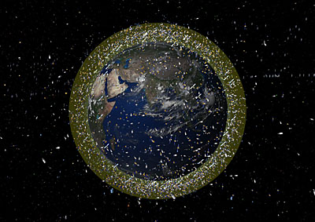
Satellites of the Earth
GPS Satellites – Orbits inclined at 55º to the equator
Weather Satellites
Debris in Orbit
All orbits of satellites have the Earth as its centre

Slide 24
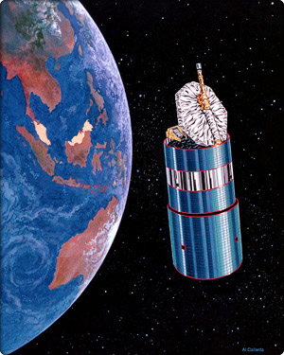
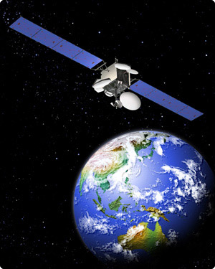
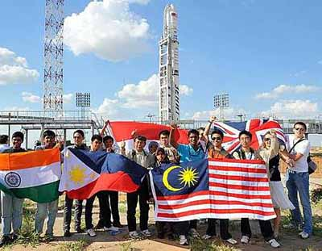
Measat
Launch of Measat 3a (21 June 2009)
http://www.youtube.com/watch?v=VIj5nZH6MH8 3a

Slide 25
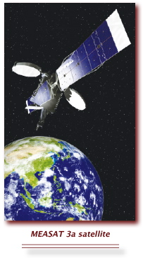
Measat
Measat 1 is now named Africasat.
Measat 1 & 2
Launch Date: Jan 1996 – 46.0ºE
Nov 1996 – 148.0ºE
Measat 3 / 3a
Launch Date: Dec 2006 / Jun 2009
Orbital Slot: 91.5ºE

Slide 26
Example 1: P41/Oct-Nov 2009
(a) State Newton’s law of gravitation.
(b) The Earth may be considered to be a uniform sphere of radius R equal to 6.4 × 10⁶ m.
A satellite is in a geostationary orbit.
(i) Describe what is meant by a geostationary orbit.
(ii) Show that the radius x of the geostationary orbit is given by the expression gR² = x³ω ²
where g is the acceleration of free fall at the Earth’s surface and ω is the angular speed of the satellite about the centre of the Earth.
(iii) Determine the radius x of the geostationary orbit.

Slide 27
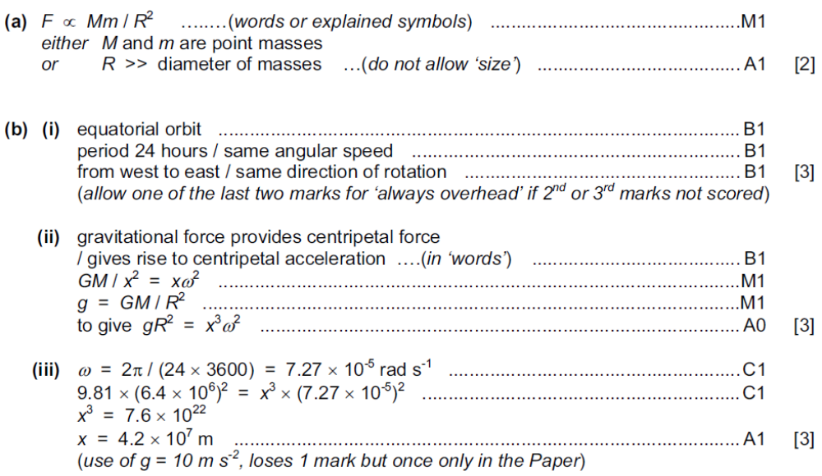
Solution 1: P41/Oct-Nov 2009

Slide 28
Example 2: P42/Oct-Nov 2009
(a) The Earth may be considered to be a uniform sphere of radius 6.38 × 10³ km, with its mass concentrated at its centre.
(i) Define gravitational field strength.
(ii) By considering the gravitational field strength at the surface of the Earth, show that the mass of the Earth is 5.99 × 10²⁴ kg.
(b) The Global Positioning System (GPS) is a navigation system that can be used anywhere on Earth. It uses a number of satellites that orbit the Earth in circular orbits at a distance of 2.22 × 10⁴ km above its surface.
(i) Use data from (a) to calculate the angular speed of a GPS satellite in its orbit.
(ii) Use your answer in (i) to show that the satellites are not in geostationary orbits.
(c) The planes of the orbits of the GPS satellites in (b) are inclined at an angle of 55° to the Equator.
Suggest why the satellites are not in equatorial orbits.

Slide 29
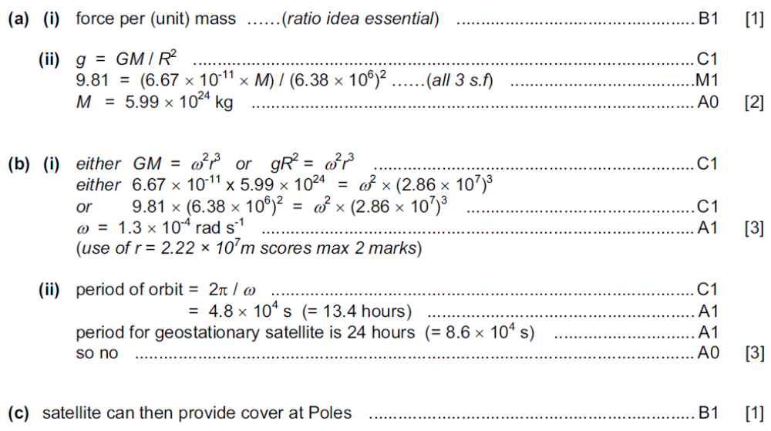
Solution 2: P41/Oct-Nov 2009

Slide 30
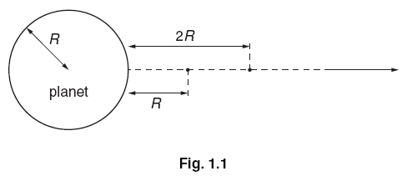
Practice 3
Explain what is meant by a gravitational field.
A spherical planet has mass M and radius R. The planet may be considered to have all its mass concentrated at its centre. A rocket is launched from the surface of the planet such that the rocket moves radially away from the planet. The rocket engines are stopped when the rocket is at a height R above the surface of the planet, as shown in Fig. 1.1. The mass of the rocket, after its engines have been stopped, is m.
(i) Show that, for the rocket to travel from a height R to a height 2R above the planet’s surface, the change ΔE_{P} in the magnitude of the gravitational potential energy of the rocket is given by the expression ΔE_{P} = GMm / 6R
(ii) During the ascent from a height R to a height 2R, the speed of the rocket changes from 7600 m s^{–1} to 7320 m s^{–1}. Show that, in SI units, the change ΔE_{K} in the kinetic energy of the rocket is given by the expression ΔE_{K} = (2.09 × 10⁶) m.
(c) The planet has a radius of 3.40 × 10⁶ m.
(i) Use the expressions in (b) to determine a value for the mass M of the planet.
(ii) State one assumption made in the determination in (i).

Slide 31
Solution 3
(a) (region of space) where a mass experiences a force
(b) (i) potential energy = (–)GMm / x
ΔE_{P} = GMm/2R – GMm/3R
= GMm/6R
(ii) E_{K} = ½m (7600² – 7320²)
= (2.09 × 10⁶)m
(c) (i) 2.09 × 10⁶ = (6.67 × 10^{–11} M) / (6 × 3.4 × 10⁶)
M = 6.39 × 10²³ kg
(ii) e.g. no energy dissipated due to friction with atmosphere/air
rocket is outside atmosphere
not influenced by another planet etc.

Slide 32
THE END

